Slide 1
SENTIMENTAL ANALYSIS WITH WEB SCRAPING
Project Team ID:
CSE20PT40
GIUDE: SAVITA S
Assistant Professor Dept. Of CSE,
CSE, JSSATEB
TEAM MEMBERS
Dhruva V | 1JS18CS403
Pruthviraj G | 1JS18CS416
Purushothama N | 1JS18CS420
Gagan M S | 1JS17CS035

Slide 2
DESIGN AND IT’S IMPLEMENTATION
SYSTEM DESIGN
Front End
Link For
The Product
Web Scrapping Unit
Scraped Data
(reviews and rating)
Result For
The Product
Data Cleaning Unit
Cleaning Data
Removed special char
EDA Model
Processed Data
Sentimental Model

Slide 3


DESIGN AND IT’S IMPLEMENTATION
FRONT END
CLIENT
BROWSER
REQUESTS
WEB SERVER
HTTP REQUESTS
HTML & JSON
The user can interact with our product through the web page
This is implemented using Flask & Bootstrap 5
Link for the product is sent to server

Slide 4
DESIGN AND IT’S IMPLEMENTATION
WEB SCRAPING UNIT
Load Web Pages With ‘request’
The HTTP request returns a Response Object with all the response data (content, encoding, status, and so on)
Using a library called BeautifulSoup in Python to do web scraping.
Do for all review page
At end saved to a .csv file
Scrap the reviews data
Append New Data
Last Page?
NO
YES
Save to a .csv file

Slide 5
DESIGN AND IT’S IMPLEMENTATION
Data Cleaning Unit
In the cleaning unit we remove the unwanted data from the[ie scraped text data] then we convert the text[review column] to lowercase and remove integers or numericals in text.
Punctuations, null values and extra[spaces as they don’t make any sense] and all these things are done by importing regular expressions[import re] Stop words are ‘this is in’, which does not add much value.
So, we remove them to decrease the size of data set this process is called normalizing text[with spacy]spacy is most versatile and widely used library in NLP Lemmatization is nothing but normalization of words which means reducing a word into its root form.
LOAD CSV FILE
CLEAN DATA
CLEANED DATA

Slide 6
DESIGN AND IT’S IMPLEMENTATION
SENTIMENTAL MODEL
Sentiment analysis is done VADER technique:
VADER[Valence Aware Dictionary for sentient Reasoning] is a Unsupervised model used that is adaptive to interpret emotional [positive/negative] and emotional [strength] text feelings..
VADER is focused on the lexicons of words related to sentiment. Each of the words in the lexicon is rated as to whether it is positive or negative and assigns scores to them.
It uses to polarity scores method to get the sentiment metrics for a piece of text.
CLEANED WORDS
VADER TECHNIQUE
RESULT

Slide 7
DESIGN AND IT’S IMPLEMENTATION
EDA MODEL
EDA stands for Exploratory Data Analysis.
It is a process of exploring data, generating insights, testing hypotheses, and revealing underlying hidden patterns in the data.
We will create a Document Terms Matrix that we’ll later use as our analysis to get the insights in data and with the help of wordcloud.
CLEANED WORDS
EDA TECHNIQUE
RESULT

Slide 8
Modern tool usage
Here we use different python modules;
FLASK MODULE : Flask is a lightweight WSGI web application framework.
AMAZON_PRODUCT_REVIEW_SCRAPER MODULE : Uses the Amazon Simple Product API to provide API accessible data.
PANDAS MODULE : pandas is a Python package that provides fast, flexible, and expressive data structures designed to make working with structured (tabular, multidimensional, potentially heterogeneous) and time series data both easy and intuitive.
REQUESTS MODULE : The requests module allows you to send HTTP requests using Python.
BeautifulSoup MODULE : Beautiful Soup is a library that makes it easy to scrape information from web pages.
and many more modules

Slide 9
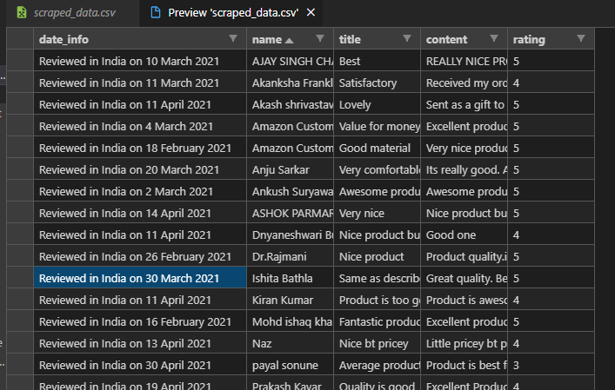
Result Obtained So Far

Slide 10
THANK YOU

